Slide 1


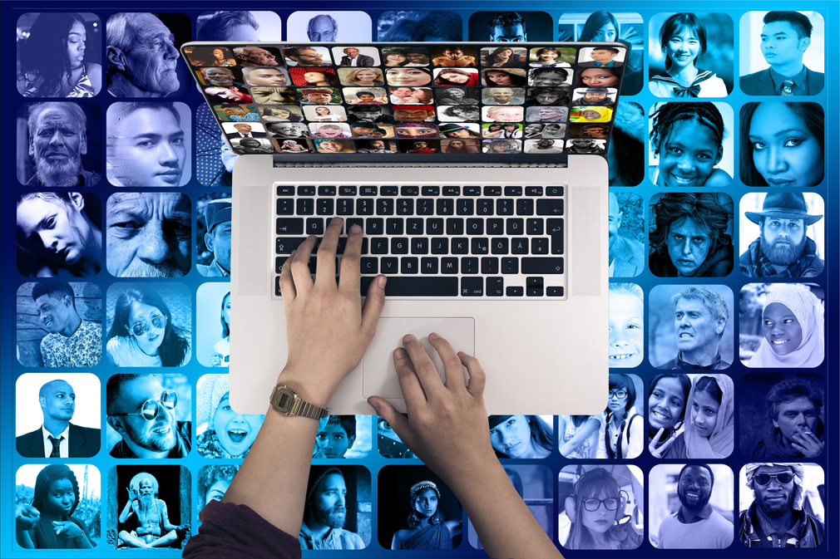




TECHNOLOGY
& ITS IMPACT
ON EDUCATION
1

Slide 2


TABLE OF CONTENT
Introduction.
What is technology?
What is education?
Types of technology used in education.
Impact .
Advantages.
Disadvantages.
Conclusion.
2

Slide 3


INTRODUCTIONS
Technology has changed the way we learn and teach. It brings both benefits and challenges to education. Here, we'll look at what technology and education are, types of tech used in education, and its impact.
The impact of technology can be felt in every possible field one such field is Education.
3

Slide 4
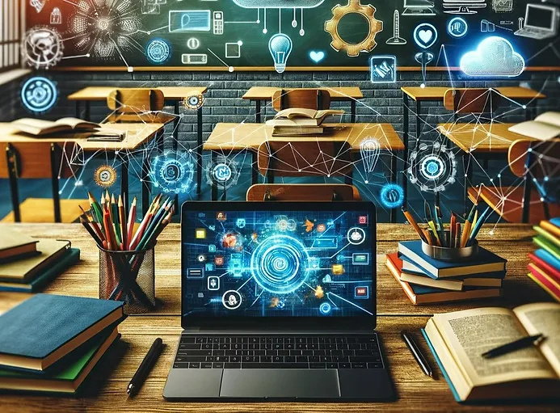
What is technology?
4

Slide 5
Technology is the use of tools, Machhines, techniques, and sources of power to make our life easy and solve the problem.
Technology is a term that refers to a body of knowledge, that is employed to generate tools, create skills, and choose materials for human use.
5

Slide 6


WHAT IS EDUCATION
6

Slide 7
Education in its general sense is a form of learning
In which the knowledge, skills, and habits of a group of people are transferred from one generation to the next through teaching, training, or research.
7

Slide 8
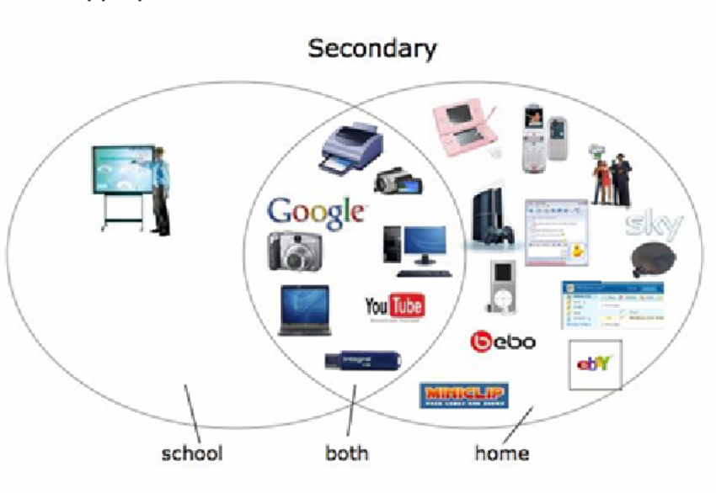
SOME TYPES OF TECHNOLOGY USED IN EDUACTION
8

Slide 9
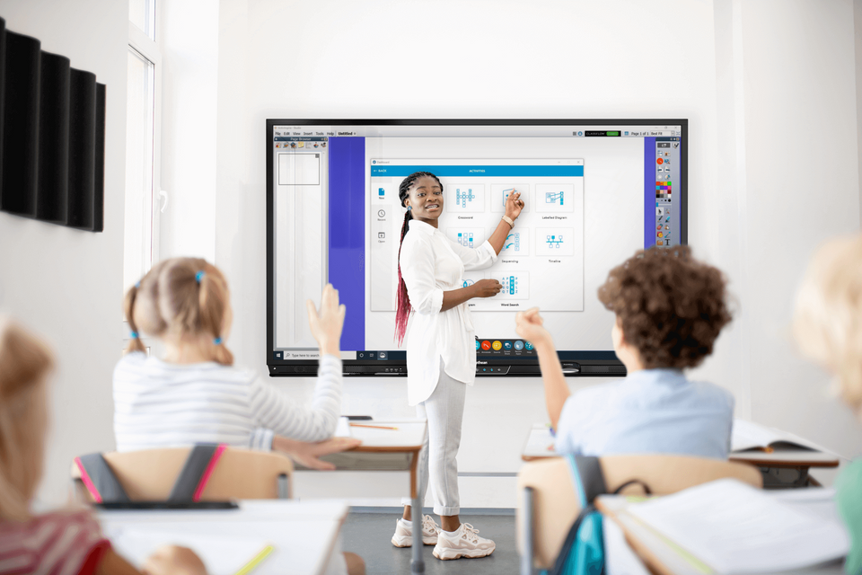
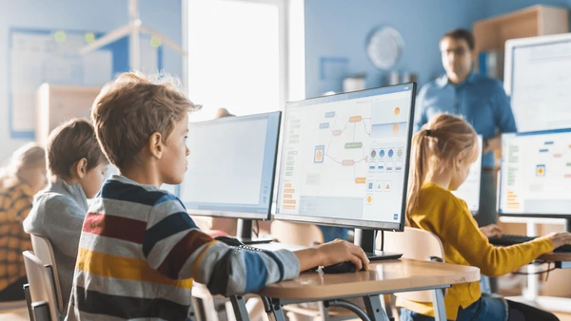

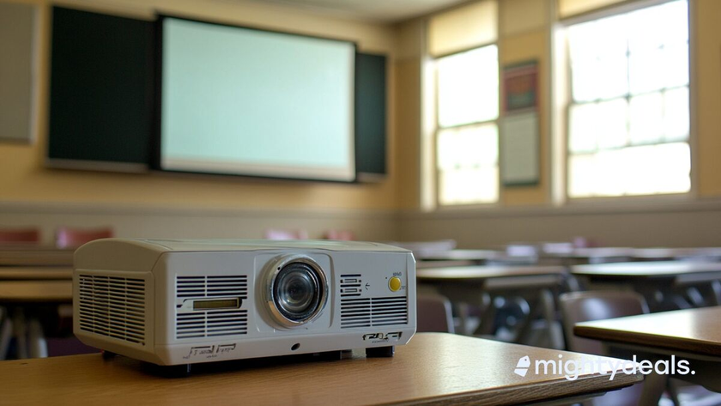
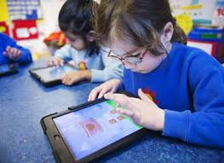
Smart Board
Classroom pc
Projectors
Tablet
9

Slide 10

Impact
POSITIVE
Access to Information: Students can learn from anywhere.
Collaboration: Technology makes it easier for students and teachers to work together.
Engagement: Interactive tools make learning fun and interesting.
10

Slide 11



Impact
Negative
1. Declining Writing Skills:
Due to the excessive usage of online chatting and shortcuts, the writing skills of
today's young generation have declined quite tremendously.
2. Increasing Incidents of Cheating:
Technological developments like graphing calculators, high tech watches, mini cameras and similar equipment have become great sources to cheat in exams.
It is easier for students to write formulas and notes on graphing calculators, with least chances of being caught.
11

Slide 12

ADVANTAGE
12

Slide 13
Better Communication: Quick and easy contact between teachers and students.
Flexibility: Learn at your own pace, anytime.
Cost-Effective: Can be cheaper than traditional methods.
Future Skills: Prepares students for tech-based jobs.
13

Slide 14

DISADVANTAGES
14

Slide 15

Many experts and experienced people say that, due to such technology in education, students imagination is affected, their thinking ability is reduced.
Also its sometime time-consuming from teacher's point of view.
It is costly to install such technology.
There can be health issues too when used over limit.
some students can't afford modern computer technologies
15

Slide 16

CONCLUSION
In the conclusion
Technology has a very positive impact on education and at the same time may also pose negative effects.
Teachers, and students should take advantage of this in the good light and eliminate the drawbacks which are pulling back many of students as well as schools_from achieving excellence
it is thus time for every country to introduce a more technologically equipped education sector in the future.
16

Slide 17

THANK YOU
17

